Slide 1

CUSTOMER CHURN PREDICTION USING MACHINE LEARNING
BY
G. SANDILYA SRINIVAS (17311A19E6)
S. LIKHIT KUMAR (17311A19E7)
J. PAVAN GANESH (17311A19G8)
Mentor : Ms. M. Shailaja

Slide 2
CONTENT
ABSTRACT
INTRODUCTION
LITERATURE SURVEY
TECHNOLOGY STACK USED
BLOCK DIAGRAM
LIBRARIES REQUIRED
DATASET USED
PROPOSED SYSTEM
USE-CASE DIAGRAM
IMPLEMENTATION AND OUTPUTS
FUTURE SCOPE
CONCLUSION

Slide 3
ABSTRACT
Customer relations is of utmost importance for industries that directly provide goods and services to the people. The goodwill of the customers is what keeps the company up and running in many of the sectors such as telecom, banking, educational institutions, etc,.
In such a fast set-up, service and goods providers have realized the importance of retaining the on-hand customers.
We predict the customer churn rate, using Machine Learning models which will indicate whether a customer will leave the bank or not based on many factors, this in turn will help the bank in knowing which category of customers generally tend to leave the bank.
Further the banks can bring in exciting offers so that it can retain its customers.

Slide 4
INTRODUCTION
In an era where the markets have become mature, new technologies have been on the rise it becomes fundamental for almost every organization in any business sector to manage relationships with their customer base in order to maintain the levels of revenue and also the standards of business for the customers to rely on.
Customer churn, also known as customer attrition is the term coined for the probability of whether an existing customer continues his/her transactions with the organization or not.
The probability factor of this parameter depends on numerous other factors in various industries like banking, telecom and few other sectors.
Importance of customers and customer churn was identified by various leading companies, they started to gather data on customer behavior like how often does a customer purchase a product,etc,.
This project deals with the customer churn in a banking sector and highlights the various factors that affect the attrition of customers from the bank.

Slide 5
LITERATURE SURVEY
Customer churn, also known as customer attrition, which is the percentage of customers that stopped using a company’s service during a particular period.
Keeping churn rates as low as possible is what every business pursuits, and understanding these metrics can assist companies to identify potential churners in time to prevent them from leaving the client base.
By being aware of and monitoring churn rate, organizations are equipped to determine their customer retention success rates and identify strategies for improvement.
Various organizations calculate customer churn rate in a variety of ways, as churn rate may represent the total number of customers lost, the percentage of customers lost compared to the company’s total customer count, the value of recurring business lost, or the percent of recurring value lost.
One of the most commonly used methods for calculating customer churn is to divide the total number of clients a company has at the beginning of a specified time period by the number of customers lost during the same period.

Slide 6

TECHNOLOGY STACK USED
PYTHON PROGRAMMING
Python is used as it has a lot of built-in libraries which we will use to develop ‘Customer Churn Prediction System’.
We will be needing Python 3.6 and higher versions.

Slide 7

JUPYTER NOTEBOOK
The Jupyter Notebook is an open source web application that you can use to create and share documents that contain live code, equations, visualizations, and text.
Jupyter Notebook is maintained by the people at ‘Project Jupyter’.
The name, Jupyter, comes from the core programming languages that it supports: Julia, Python, and R.

Slide 8
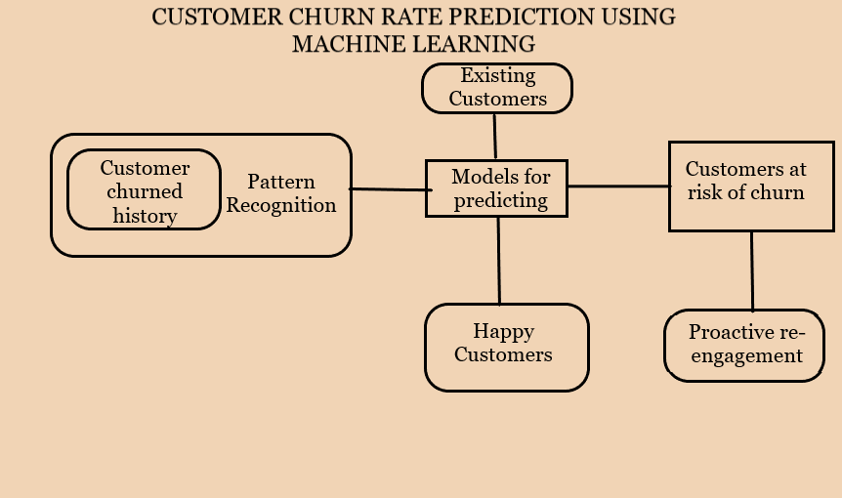
BLOCK DIAGRAM

Slide 9



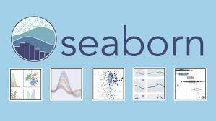
LIBRARIES REQUIRED
The basic and significant libraries used are:
Pandas
NumPy
Seaborn
Matplotlib

Slide 10
The Machine Learning libraries used are:
Logistic Regression
Decision Tree Classifier
Random Forest Classifier
K-Neighbors Classifier
AdaBoost
XGB Classifier

Slide 11
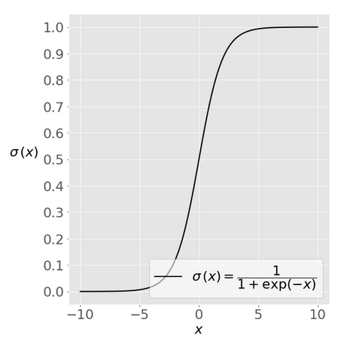
LOGISTIC REGRESSION
Logistic regression is a basic classification technique. It belongs to the linear classifiers group and is similar to polynomial and linear regression.
Logistic regression is a simple and rapid method for predicting results, and it is ideal for you to use.
Although it is primarily a binary classification approach, it may also be used to address multiclass issues such as this concept.

Slide 12
DECISION TREE CLASSIFIER
A decision tree is a popular machine learning method. Internal decision-making logic is shared, which is not available in black box algorithms like Neural Network.
When compared to the neural network approach, it takes less time to train.
The decision tree is a non-parametric or distribution-free classifier that does not rely on probability distribution assumptions.
Decision trees can handle large amounts of data and yet make accurate predictions.The following is the basic concept underlying every decision tree algorithm:
To split the records, choose the relevant attribute using Attribute Selection Measures (ASM).
Split the dataset into small-scale subgroups using that property as a decision node.
Begin building the tree by recursively repeating this series of steps for each child until one of the conditions fits:
o Each tuple corresponds to the same attribute value.
o There are no more traits that have been left behind.
o All scenarios are addressed.

Slide 13
RANDOM FOREST CLASSIFIER
Random forest is a learning method that is supervised. This classifier may be used for both classification and regression. Random forest is also very adaptable and simple to utilise. Trees make up a forest.
Random forests create decision trees based on randomly selected data samples, obtain forecasts from each tree, and use the voting concept to select the best potential answer.
Random forest is essentially an ensemble technique of decision trees constructed on an arbitrarily divided dataset (based on the divide-and-conquer methodology). The forest is the name given to a group of decision tree classifiers.
In comparison to other non-linear classification methods, it is simpler and more resilient.

Slide 14
K- NEIGHBORS CLASSIFIER
The supervised machine learning method K-nearest neighbours (KNN) is a kind of KNN algorithm. KNN is relatively simple to implement in its most basic form, yet it performs a wide range of classification tasks.
It is a slow learning algorithm since it does not have an exclusive training phase. Rather, it trains on all of the data while categorising a new data point or instance.
KNN is a non-parametric learning method since it makes no assumptions about the raw data. This is a particularly useful characteristic because the vast majority of real-world data defies theoretical assumptions such as linear separability, uniform distribution, and so on.

Slide 15
ADABOOST CLASSIFIER
Boosting algorithms have been more popular and well-known among data science and machine learning enthusiasts in recent years.
Boosting algorithms combine many low-accuracy (or weak) models to produce a high-accuracy (or strong) model.
In 1996, Yoav Freund and Robert Schapire introduced Ada-boost, or Adaptive Boosting, as one of the ensemble boosting classifiers. It combines numerous classifiers in order to increase classifier accuracy.
AdaBoost is a methodology for creating iterative ensembles. By cascading numerous poorly performing classifiers, the AdaBoost classifier creates a robust classifier with high accuracy and power.
Setting the weights of classifiers and training the sample data in each step is the essential notion that powers Adaboost, ensuring accurate predictions of odd data points.

Slide 16
XGB CLASSIFIER
Gradient boosting classifiers are a collection of machine learning algorithms that combine a number of weak learning models into a powerful prediction model.
Gradient boosting models are gaining popularity as a result of their efficiency in categorising compound datasets.
The idea behind "gradient boosting" is to take a bad hypothesis or a bad learning algorithm and make a series of changes to it that will improve the hypothesis's strength.
Gradient Boosting classifiers aim to reduce failure, or the gap between the training example's actual class data and the projected category value. Understanding the mechanism for reducing the classifier's loss isn't needed, although it works in a similar way to gradient descent in a neural network.

Slide 17
All the above libraries are inbuilt libraries of Python.
We need to import them from Scikit-Learn.
Scikit-learn library which is commonly known as sklearn is a free software machine learning library for the Python programming language. It features various classification, regression and clustering algorithms

Slide 18
DATASET USED
This Dataset is an open-source dataset which is obtained from Kaggle.
The name of the Dataset used is “Bank Customer Churn Data”.
This dataset contains 10000 records and 14 features.
The features of this dataset are:
'RowNumber', 'CustomerId', 'Surname', 'CreditScore', 'Geography', 'Gender', 'Age', 'Tenure', 'Balance', 'NumOfProducts', 'HasCrCard', 'IsActiveMember', 'EstimatedSalary', 'Exited’ .
Out of these, Surname, Geography and Gender are string data which need on which encoding will be performed.
This data does not contain any missing values. So, no imputations need to done.
The Target variable is the “Exited” variable which indicates whether a customer has left and which customer is with the bank.

Slide 19
PROPOSED SYSTEM
We chose “Python” as our base programming language to proceed with building the model as stated earlier in this presentation.
Scikit Learn library provides all the necessary machine learning models that will be used in this project.
Before giving data to the model, there are a lot of data pre-processing steps that need to be done in order to achieve the maximum accuracy with the models that we have selected.
Data pre-processing is the most basic and important step in any machine learning project.
We intend to make a front end where the values entered gives the output which will help the company know whether the customer/client is staying or leaving the organization/bank.

Slide 20
Data Pre-Processing Steps:
Data Cleaning.
Data Encoding
Dealing with Outliers
Data Transformation
Data Visualization
After these steps, comes the ML modelling part where we train our model according to our data and then test it on same data which is separated before hand.

Slide 21
USE-CASE DIAGRAM

Slide 22
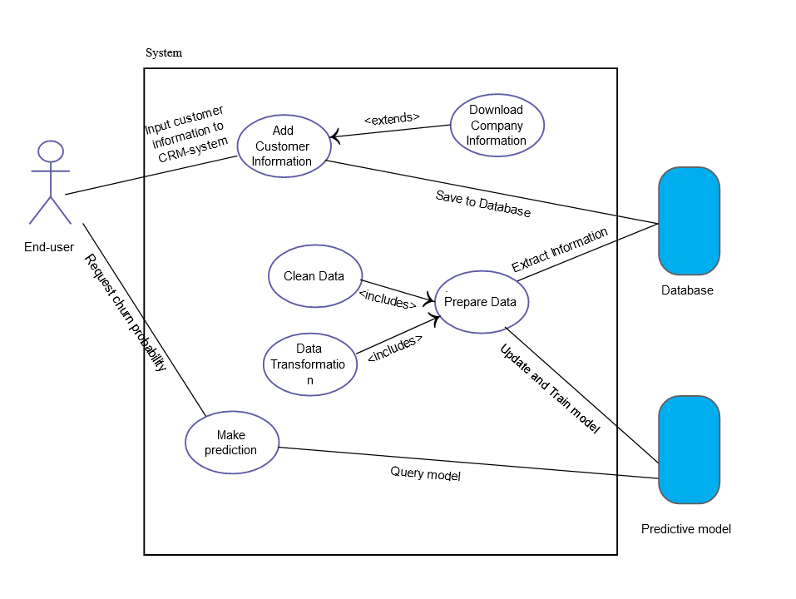

Slide 23
IMPLEMENTATION AND OUTPUTS

Slide 24
IMPLEMENTATION
Before the model is constructed there are a lot of pre processing steps that need to be done in order for the model to be properly constructed.
The model construction can be divided into three major parts:
Splitting the Predictors(X) and the Target variable(y).While splitting the features into Predictors and Target variables, we use the iloc method to split the features column wise. In our case, we have 10 features as X. Those features are:
Credit Score Geography Gender Age Tenure Balance Number of Products
Possession of Credit Card(Yes/No) Active Member(Yes/No) Estimated Salary

Slide 25
2. Splitting the X and y further. That is the test-train split. Now, we have 4 variables. X_train, X_test ; y_train, y_test. The train data is 80% of the complete data whereas the test data is 20% of the complete data sampled randomly.
We have used the train_test_split python library to split the data and defined the random state as 42.
3. Fitting the Required machine learning model using the algorithms.

Slide 26
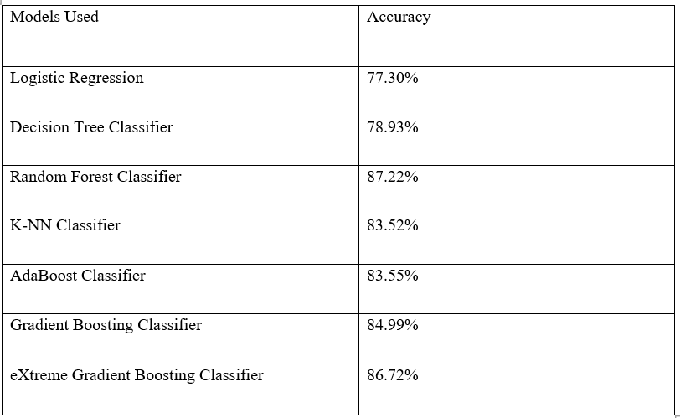
ACCURACY WITH TRAIN/TEST VALIDATION

Slide 27
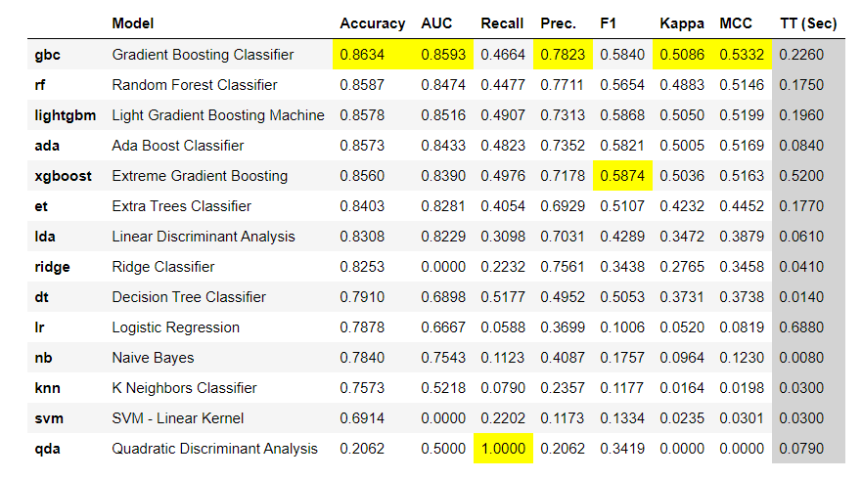
ACCURACY SCORES WITH LOOCV

Slide 28
REAL-TIME WEB APP FOR CHURN PREDICTION

Slide 29
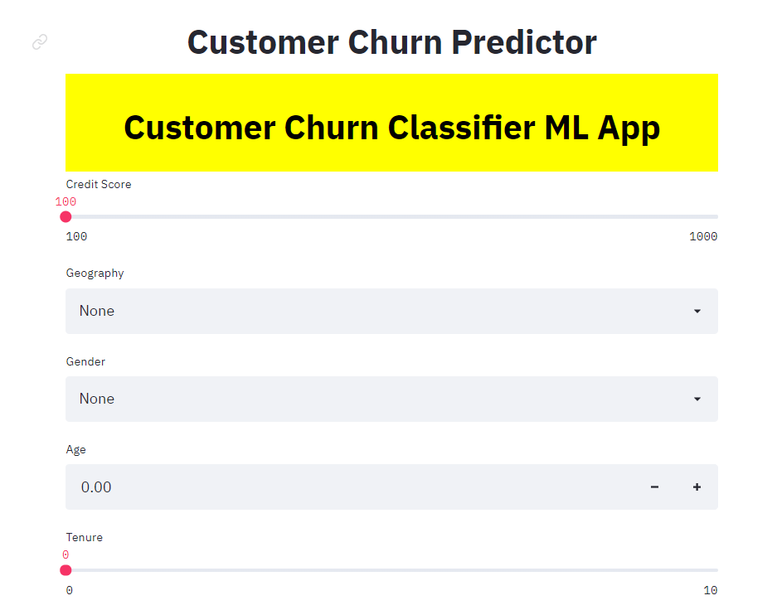
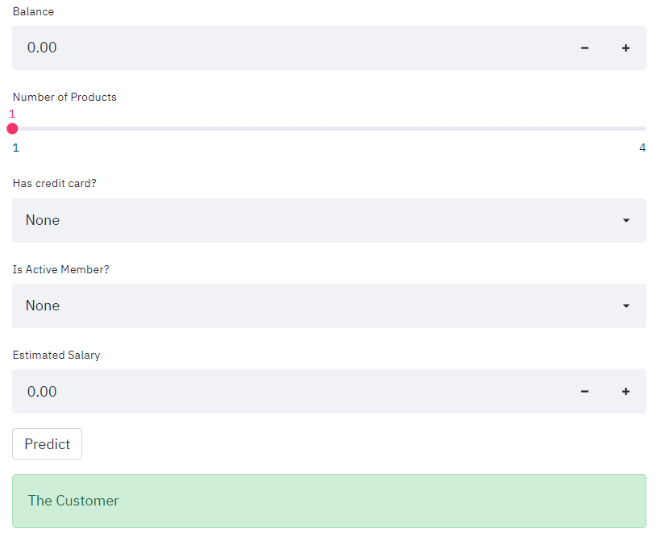

Slide 30
WEB APP SHOWING A CUSTOMER WHO’LL STAY WITH THE BANK

Slide 31
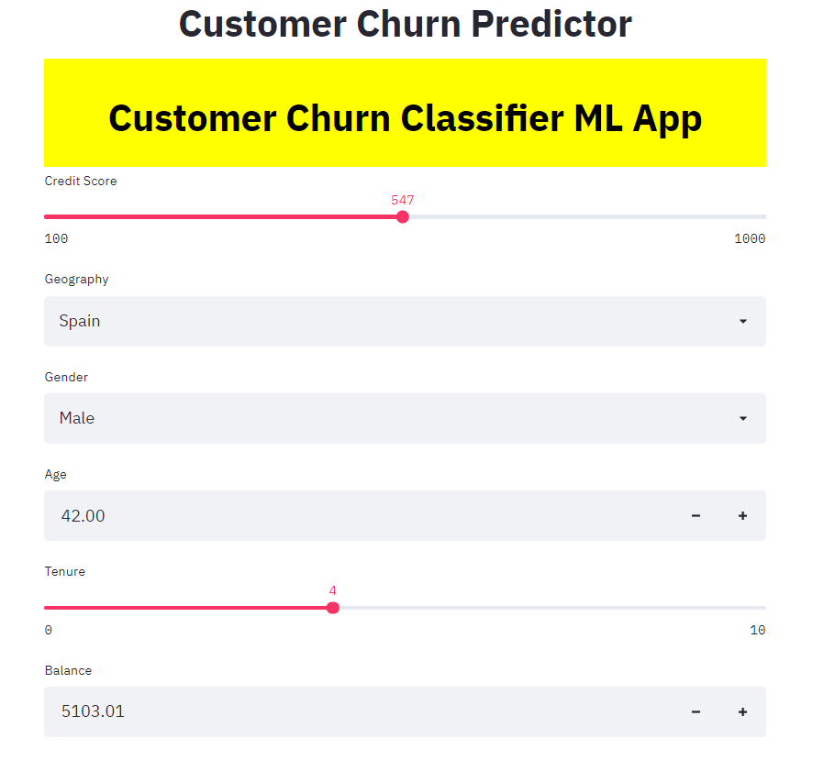
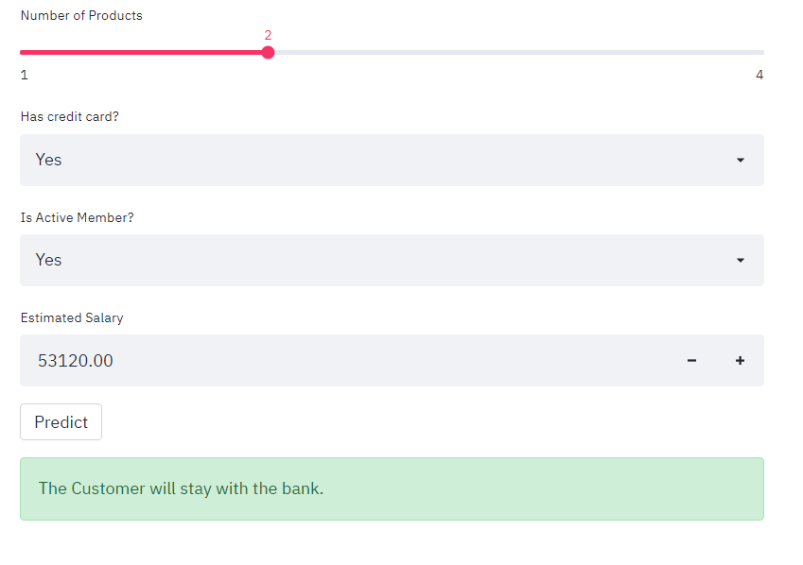

Slide 32
WEB APP SHOWING A CUSTOMER WHO IS AT RISK OF BEING CHURNED

Slide 33
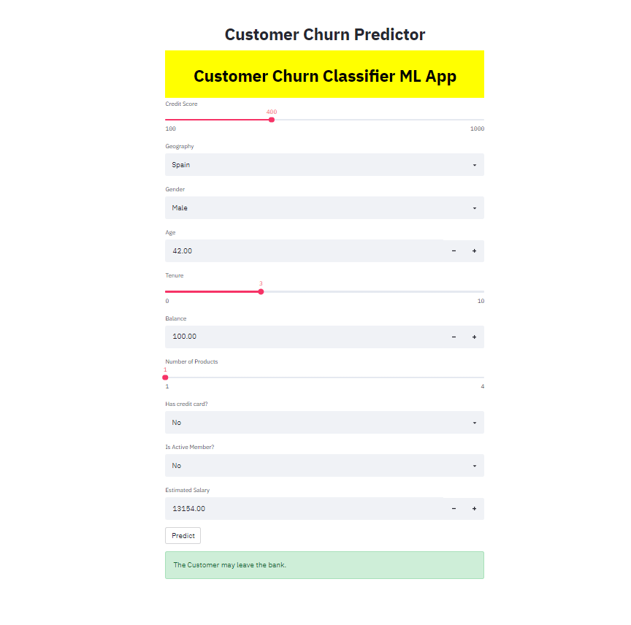

Slide 34
FUTURE SCOPE
The process of predicting churn rate by years i.e. specifically it is aimed at predicting in advance where customers are likely to leave a bank with quite good precision, avoiding costs related to false positive errors.
When the customers leave there’s a huge loss to the bank ,it should reimburse with the percentage of new customers.

Slide 35
CONCLUSION
Churn rate is a health indicator for subscription-based companies. The ability to identify customers that aren’t happy with provided solutions allows businesses to learn about product or pricing plan weak points, operation issues, as well as customer preferences and expectations to proactively reduce reasons for churn.
It’s important to define data sources and observation period to have a history of customer interaction. Selection of the most significant features for a model would influence its predictive performance: The more qualitative the dataset, the more precise forecasts are.
Companies with a large customer base and numerous offerings would benefit from customer segmentation. The number and choice of ML models may also depend on segmentation results. Data scientists also need to monitor deployed models, and revise and adapt features to maintain the desired level of prediction accuracy.

Slide 36


